Slide 1


Using the lattice Boltzmann method to model tidal flows within Dover Harbour.
By Andrew Cunningham, Jian Zhou and Jon Shiach
Centre for mathematical modelling and flow analysis, Department of Computing and Mathematics, Manchester Metropolitan University, Manchester, M1 5GD

Slide 2
Presentation Outline
Introduction
Methodology
Validation
Results
Conclusion

Slide 3
Introduction

Slide 4
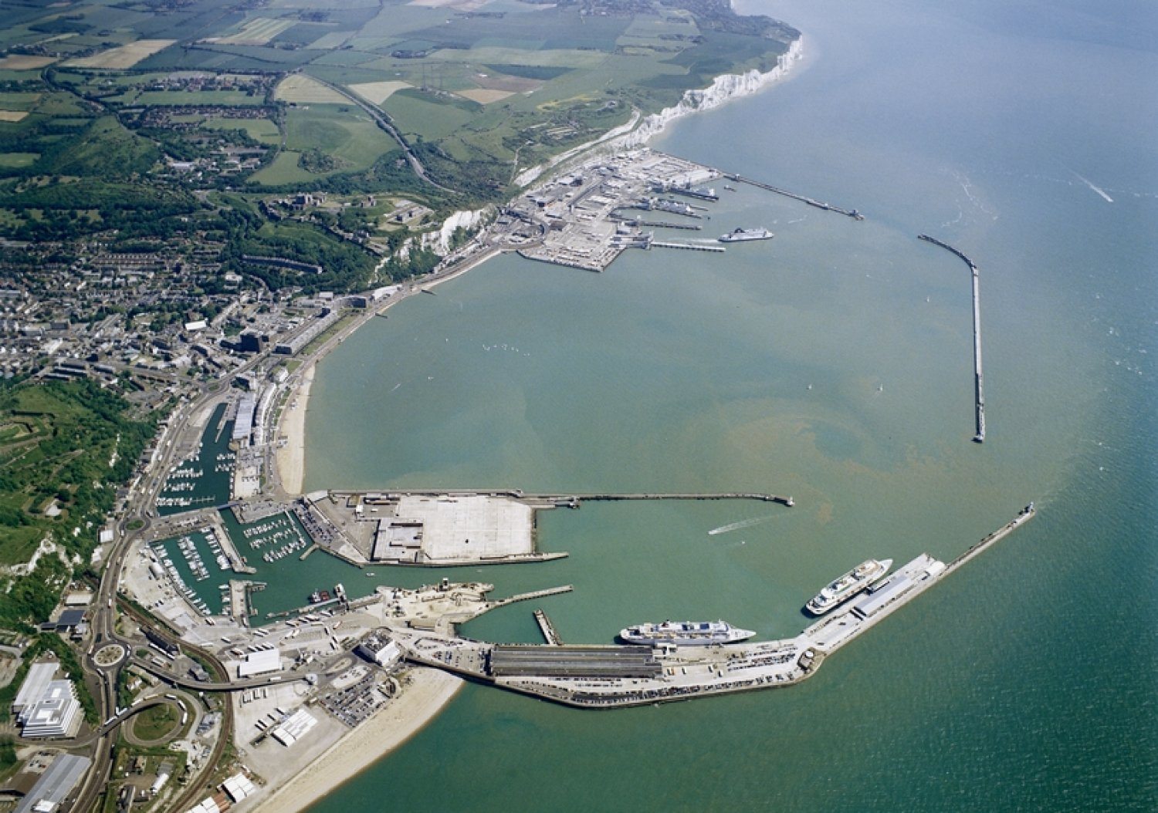
Introduction
What are we studying?
The effect of tidal flows within Dover Harbour.
Why are we studying this?
Dover Harbour requires dredging of up to 250,000m³ of sand and mud per annum.
How we are going to study it?
The harbour will be observed and mapped using the lattice Boltzmann method based on both tidal flow patterns and topological data.
Aerial view of Dover Harbour
Notes:
What are we studying?
I have been studying the effects of turbulent flows surrounding renewable devices. To meet current legislation by 2020 the UK must have a reliance of around 15% upon renewable sources, including heat, transport and electricity (Coskeran, 2010, National Renewable Energy Plan for the UK). Many other EU countries have achieved this standard and yet the UK is flagging behind. The UK is in a more favourable position for being an island and the tidal potential of around 500 – 1000 TWh/year threshold (Burrows, 2015). Unfortunately, due to funding, the tidal barrage plan for Swansea did not proceed and therefore we have swapped to another device as there have been reports that the Whirlpool turbine device could be implemented into more remote areas of the UK with access to a river.

Slide 5
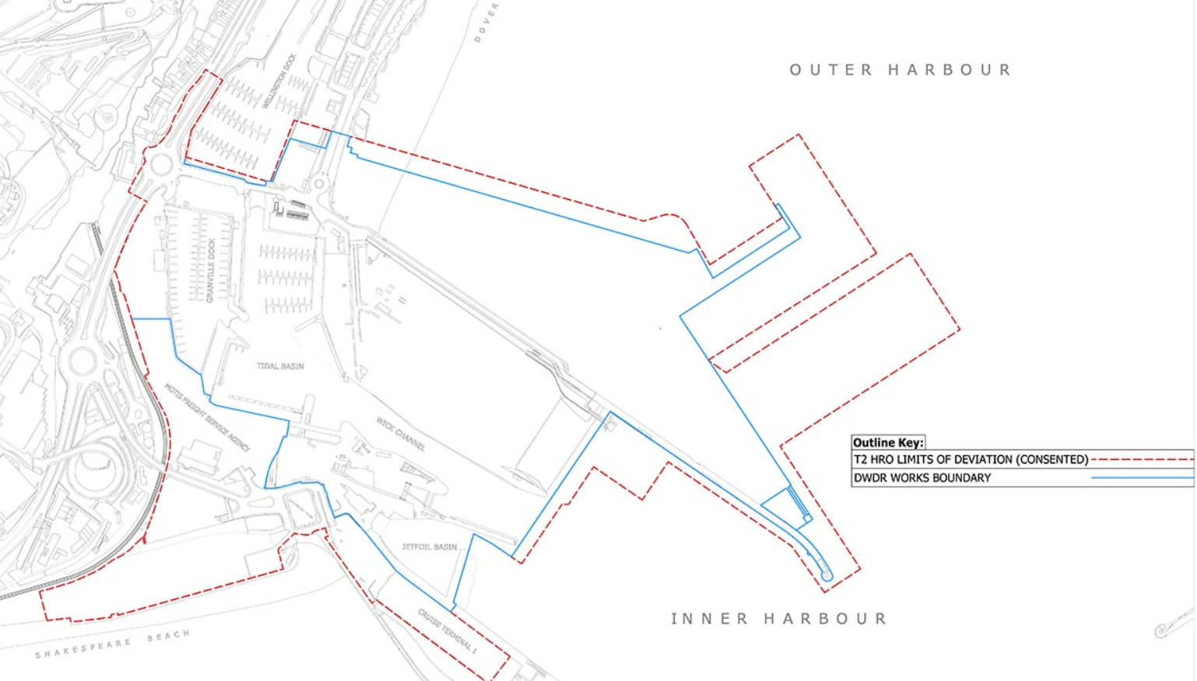
Revival of the Western Harbour

Slide 6
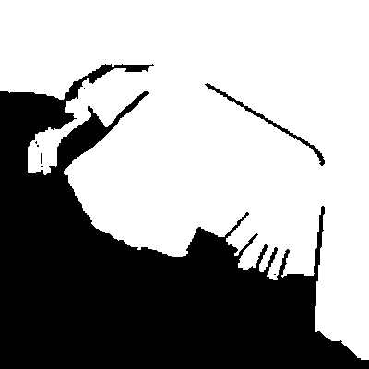
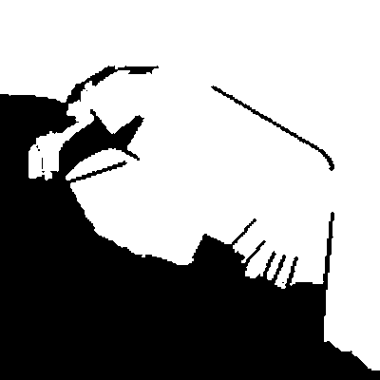
Revival of the Western Harbour
Dover Harbour 2015
Dover Harbour 2019

Slide 7
Methodology

Slide 8
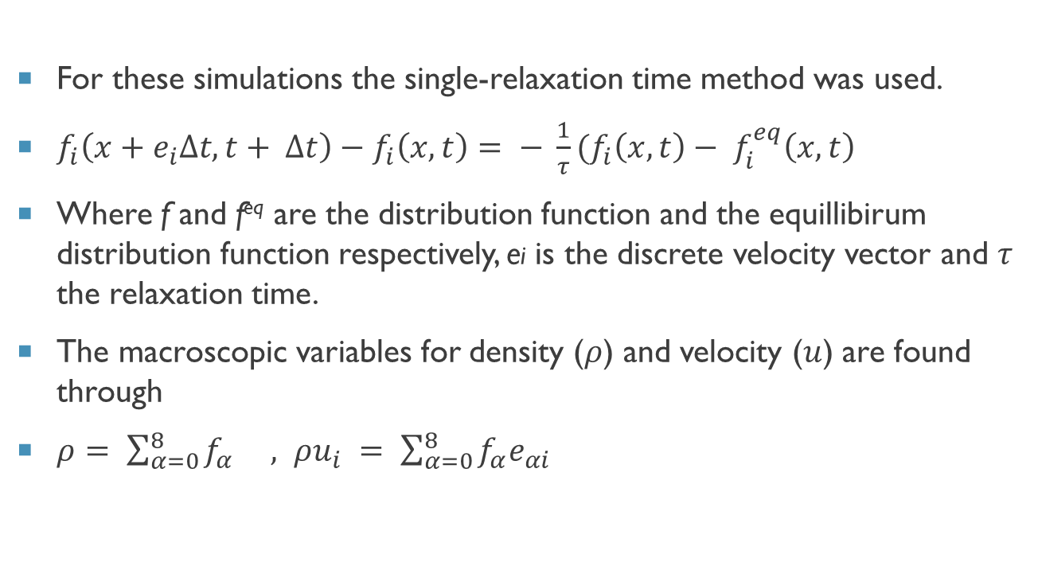
Lattice Boltzmann method (LBM)
For these simulations the single-relaxation time method was used.
$f_{i}\left(x+e_{i}∆t, t+ ∆t\right)−f_{i}\left(x, t\right)= − \frac{1}{τ}(f_{i}\left(x, t\right)− f_{i}^{eq}\left(x, t\right)$
Where f and f^{eq} are the distribution function and the equillibirum distribution function respectively, ei is the discrete velocity vector and $τ$ the relaxation time.
The macroscopic variables for density ($ρ$) and velocity ($u$) are found through
$ρ= \sum_{α=0}^{8}{f_{α} , ρu_{i} = \sum_{α=0}^{8}{f_{α}e_{αi} }}$
6
2
5
3
0
1
7
4
8
Fig 1 A D2Q9 lattice configuration

Slide 9
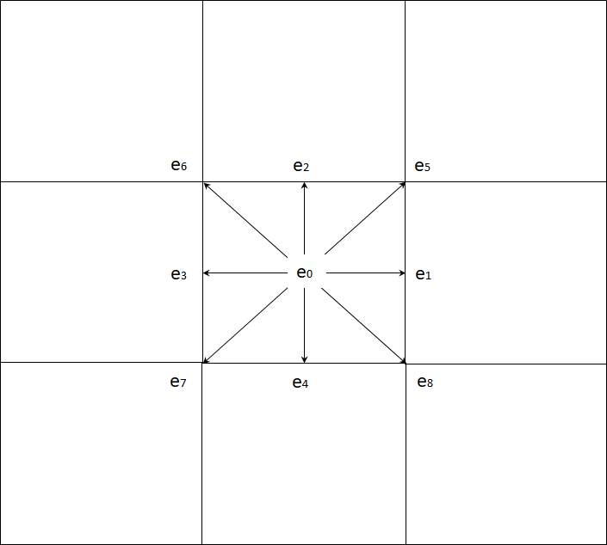
Particle Distribution

Slide 10
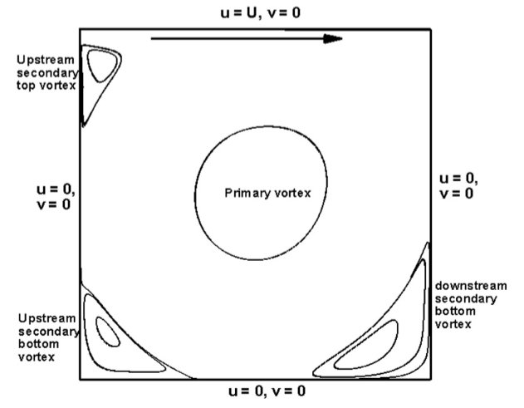
Lid-Driven cavity problem
U = u, V = 0
Upstream Secondary Vortex
U = 0
V = 0
Primary Vortex
U = 0
V = 0
Upstream Secondary Bottom Vortex
Downstream Secondary Bottom Vortex
U = 0, V = 0
Fig 5 Lid Driven Cavity (Perumal and Dass, 2013)

Slide 11
Idealised Harbour Design
Inflow
Outflow

Slide 12
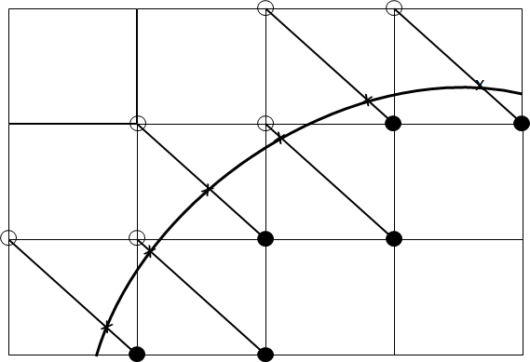
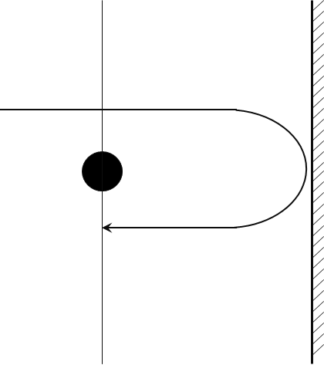
Boundary conditions (Bounceback / Non-slip)

Slide 13
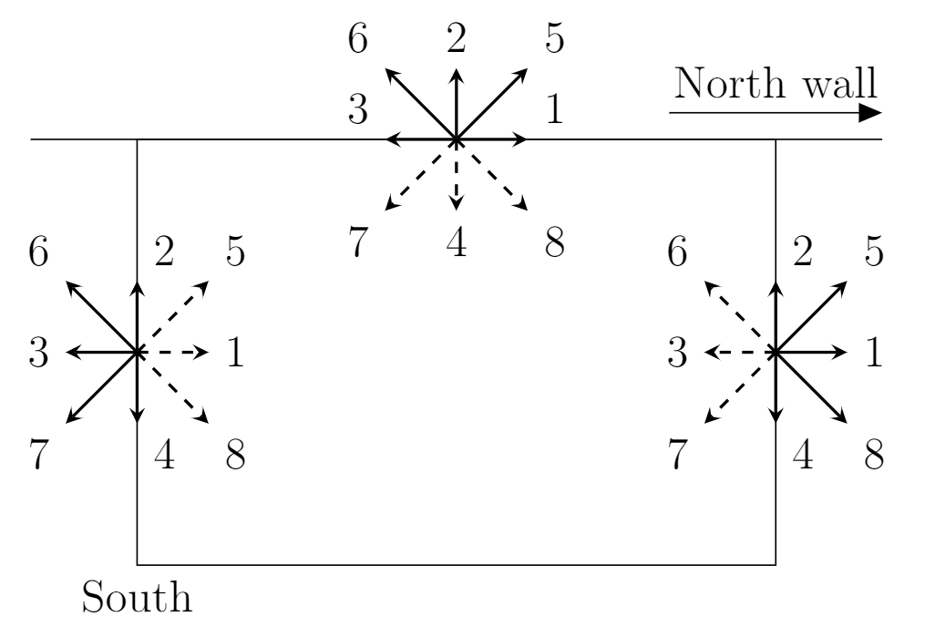
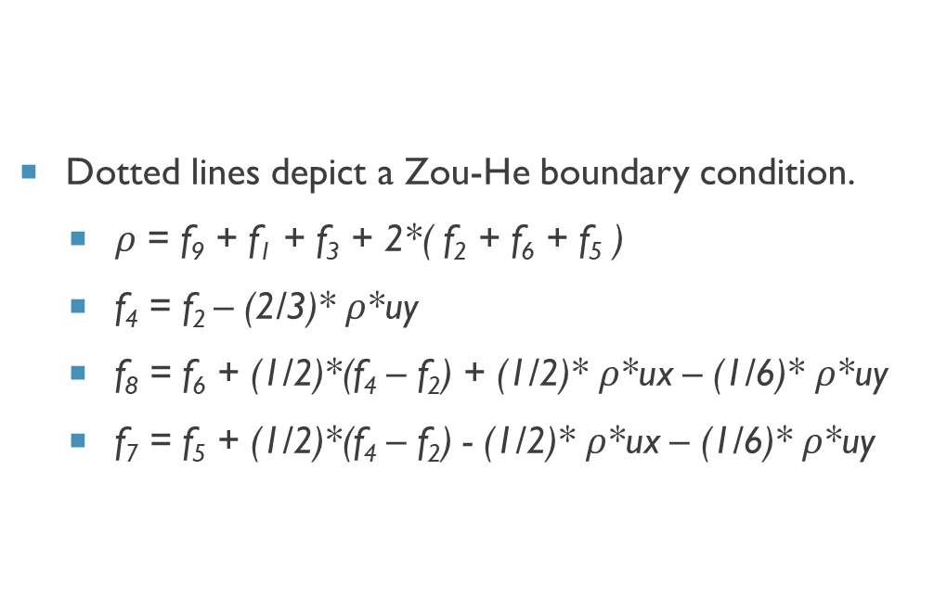
Boundary Conditions (Zou – He)
Dotted lines depict a Zou-He boundary condition.
$ρ$ = f₉ + f₁ + f₃ + 2*( f₂ + f₆ + f₅ )
f₄ = f₂ – (2/3)* $ρ$*uy
f₈ = f₆ + (1/2)*(f₄ – f₂) + (1/2)* $ρ$*ux – (1/6)* $ρ$*uy
f₇ = f₅ + (1/2)*(f₄ – f₂) - (1/2)* $ρ$*ux – (1/6)* $ρ$*uy

Slide 14
Validation

Slide 15
Benchmark of the lid-driven cavity using (Ghia1982)
Fig 6 Vertical velocity compared with Ghia’s results
Fig 7 Horizontal velocity compared with Ghia’s results

Slide 16
Results

Slide 17
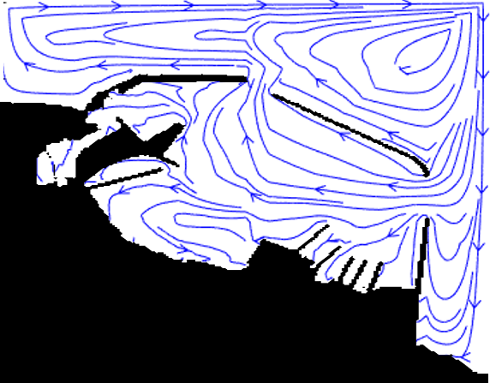
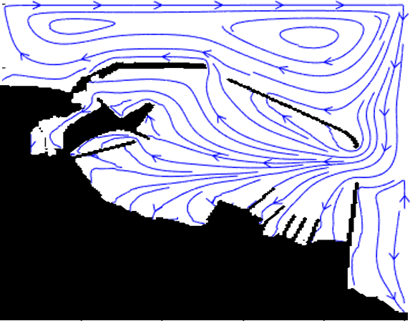
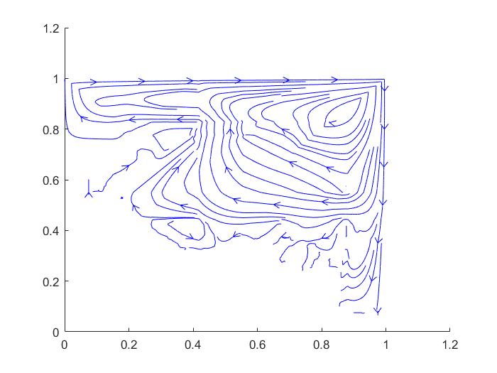
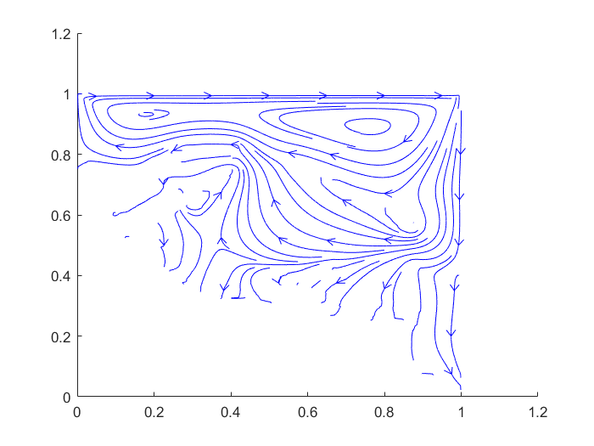
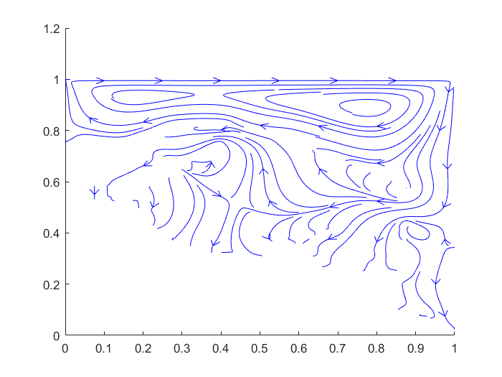
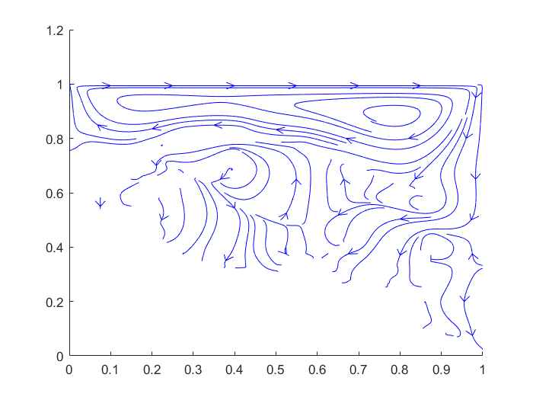
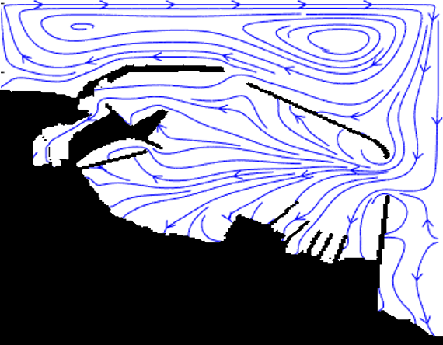
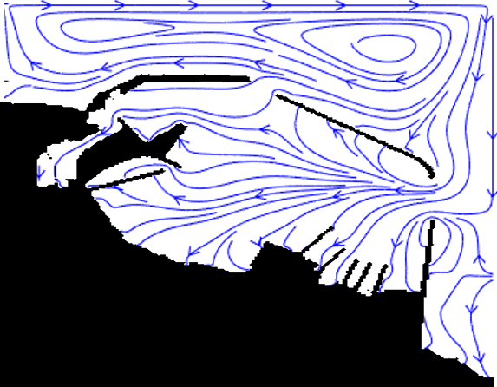
Before the Revival
Dover Harbour 2015
Dover Harbour 2019

Slide 18
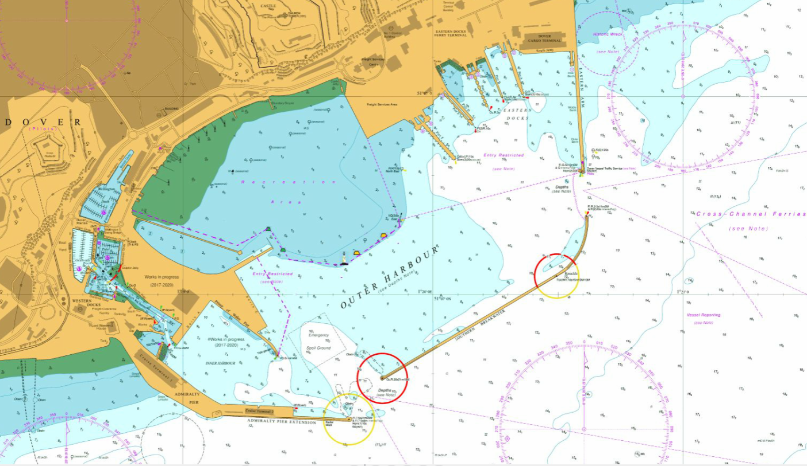
Dover Harbour Topology
Shallow
<0m
>50m
Deep

Slide 19
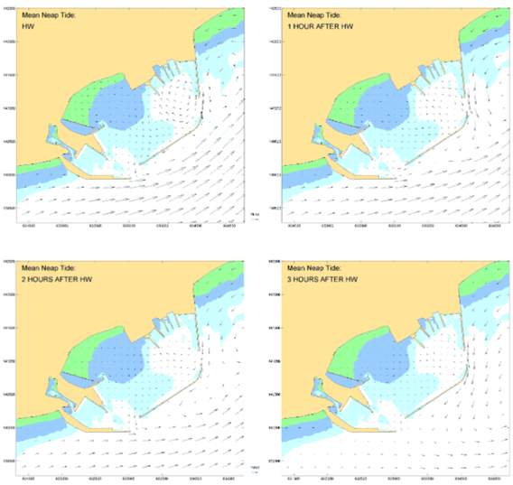
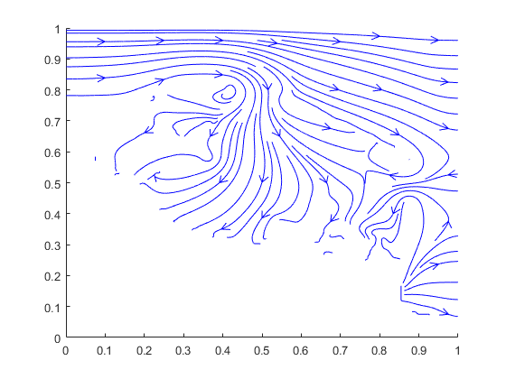
SWE Tidal Mean Flow

Slide 20
Tidal plot

Slide 21
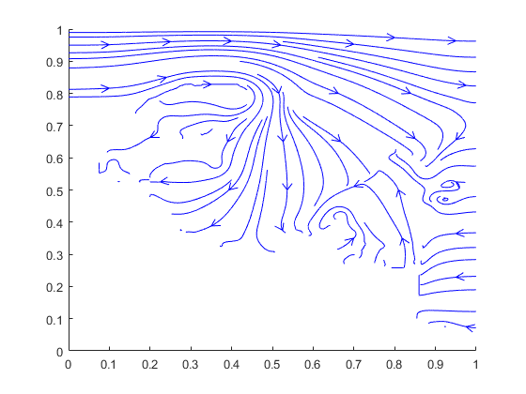
Dredging or deepening of the Outer Harbour Area
Current Harbour Depth
Increased Depth of 20m

Slide 22
Conclusions

Slide 23
Conclusions
The new expansion does not seem to have a major impact upon the flow within the harbour.
The entrances to the harbour are the main areas of concern with them being the areas of high turbulence which would increase the amount of sediment drop off.
Further work with sediment transport can be conducted to further examine the entrances to the harbour.
The SWE can predict the tidal patterns within the harbour to an appropriate degree.
Increasing the depth through dredging looks to be a good short term answer to the build up of silt along the harbour floor.

Slide 24
Advection Diffusion
Non-linear would not work with SWE.

Slide 25
References
Ghia, U, K N Ghia, and C T Shin (1982). High-Resolutions for Incompressible Flow Using the Navier-Stokes Equations and a Multigrid Method. Tech. rep., pp. 387–411.
Perumal, D. Arumuga and Anoop K. Dass (2013). “Application of lattice Boltzmann method for incompressible viscous flows”. In: Applied Mathematical Modelling 37.6, pp. 4075–4092
Wolfram, Stephen (1994). Cellular Automata and Complexity: Collected Papers.
Zou, Qisu and Xiaoyi He (1997). “On pressure and velocity flow boundary conditions and bounce-back for the lattice Boltzmann BGK model”. In: Physics of Fluids 9.6, pp. 1591–1598.

Slide 26
Thank You Any Questions?

